Slide 1
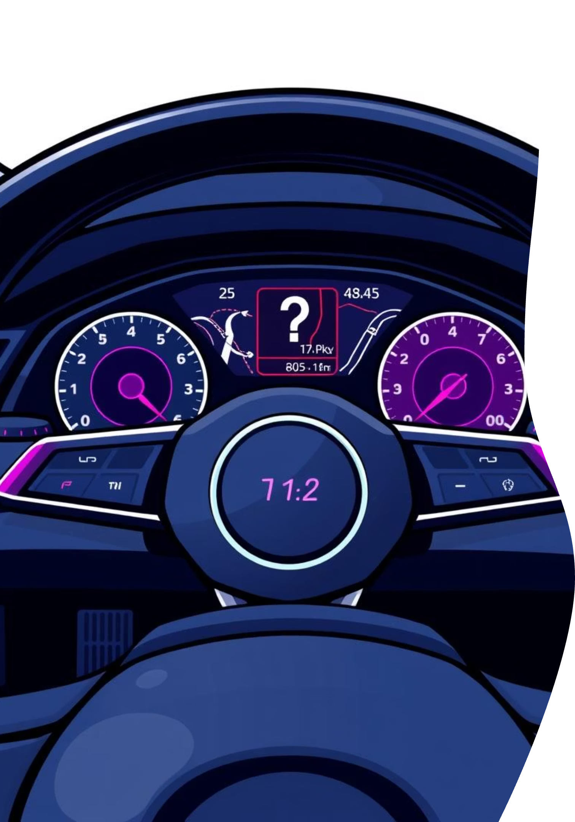

CarForSale : A Platform for car enthusiast to buy and sell car.
Presented By
Name: Sahil Sharma
Enroll: 23002171410056
Roll no: 17
Branch: CS&IT
Div: D1

Slide 2




Introduction
carforsale is a modern, full-stack web application designed to simplify the process of buying and selling used cars. Our platform provides a seamless and trustworthy experience for users, featuring:
User Authentication
Car Listings
Secure registration and login for all users.
A comprehensive system for users to list their cars with multiple photos and detailed specifications.
Advanced Filtering
AI-Powered Price Prediction
An intuitive interface to search and filter car listings by brand, city, fuel type, and transmission.
A machine learning model that provides instant, data-driven price estimates for used cars.

Slide 3

How the Project Works
Our application connects a dynamic frontend with a powerful backend through a REST API.
2. Browse & Filter
1. Register & Login
View cars on the "Buy Car" page. React fetches data from Django/MongoDB. Filters trigger new API calls for refined lists.
Users create an account, securely stored in MongoDB. An authentication token is issued for access.
4. Predict a Price
3. Sell a Car
Enter car details into the prediction form. Data is sent to an API endpoint where a pre-trained ML model (Scikit-learn/Pandas) calculates and returns an estimated price.
Logged-in users complete the "Sell Car" form. Details and images are sent to the Django backend and stored in the database.

Slide 4
Technology Stack
This project was built using a modern, full-stack combination of technologies for the frontend, backend, database, and machine learning components.
Frontend
Backend
React: Interactive user interfaces.
Django: High-level Python web framework.
React Router: Client-side navigation.
Django REST Framework (DRF): Building Web APIs.
Axios: HTTP requests to API.
Simple JWT: Secure token-based authentication.
Database
Machine Learning
Scikit-learn: Training regression models.
MongoDB: Flexible NoSQL document database.
Pandas: Data cleaning & manipulation.
Djongo: Connects Django with MongoDB.
Joblib: Saving & loading ML models
Car dataset: Used car dataset from Kaggle by mohit kumar

Slide 5
Future Scope
AutoSphere has a strong foundation that can be expanded with several advanced features.
Advanced Multi-Filtering
Combine multiple filters (e.g., "Honda" + "Automatic" + "Mumbai").
Real-Time Chat
Add direct communication between buyers and sellers.
Admin Dashboard
Create own admin page with detailed analytics and user management.
Deployment
Deploy the project.
Computer Vision Model
Train a model to analyze car photos for damage detection or condition verification.

Slide 6
Thank You

